Slide 1
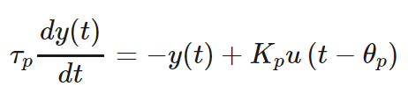
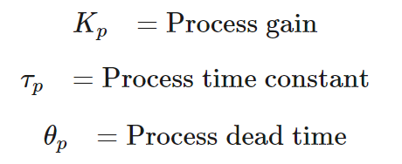
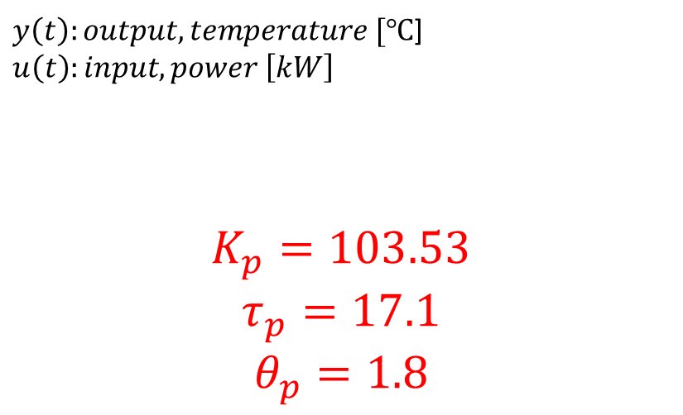
FOPDT: Friction Stir Welding
$y\left(t\right):output, temperature [℃$]$u\left(t\right):input, power \left[kW\right]$
$$K_{p}=103.53$$
$$τ_{p}=17.1$$
$$θ_{p}=1.8$$

Slide 2
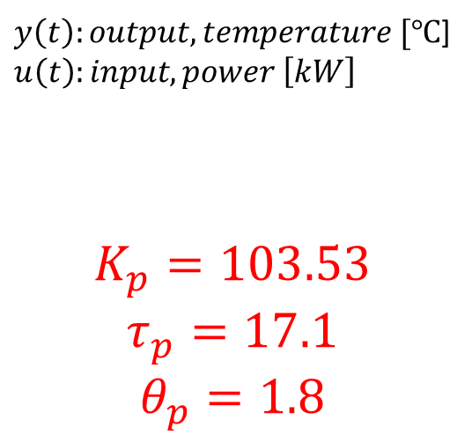
$y\left(t\right):output, temperature [℃$]$u\left(t\right):input, power \left[kW\right]$
$$K_{p}=103.53$$
$$τ_{p}=17.1$$
$$θ_{p}=1.8$$
Goodness of fit:
SSE:2915
R-square: 0.6669
Adjusted R-square: 0.6654
RMSE: 3.674
MSE:13.498276

Slide 3
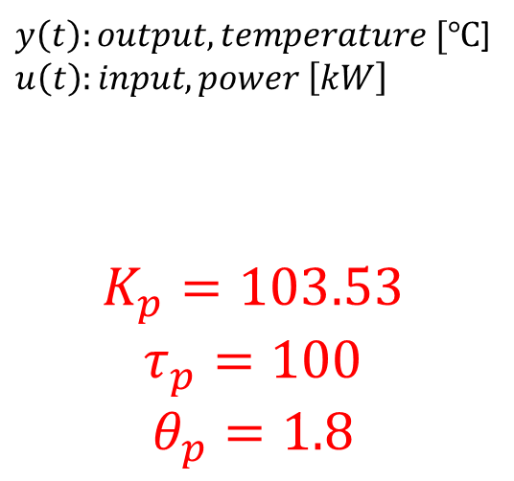
$y\left(t\right):output, temperature [℃$]$u\left(t\right):input, power \left[kW\right]$
$$K_{p}=103.53$$
$$τ_{p}=100$$
$$θ_{p}=1.8$$
Goodness of fit:
SSE:80.59
R-square: 0.6914
Adjusted R-square: 0.6899
RMSE: 0.6108
MSE:0.37307664

